Slide 1
Real or Fake News Classifacation

Slide 2
Deep Learning is a Subset of ML
Artificial intelligence
Machine Learning
Deep Learning

Slide 3
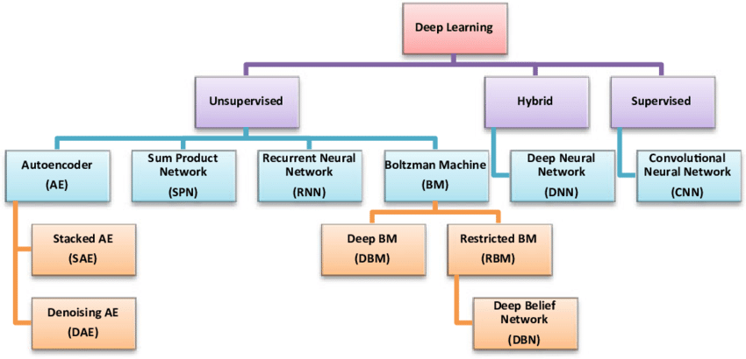
Classification of Deep Learning Techniques
Notes:
We’re going to talk about the 3 most popular ones (DNN → Feed forward neural network ), (CNN → usually used in computer vision), (RNN → Used in NLP mostly )

Slide 4
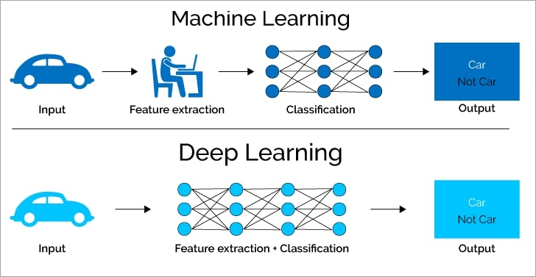
Machine Learning vs. Deep Learning

Slide 5
Machine Leaning vs. Deep Learning
Machine learning | Deep learning
A subset of AI | A subset of machine learning
Can train on smaller data sets | Requires large amounts of data
Requires more human intervention to correct and learn | Learns on its own from environment and past mistakes
Shorter training and lower accuracy | Longer training and higher accuracy
Can train on a CPU (central processing unit) | Needs a specialized GPU (graphics processing unit) to train

Slide 6
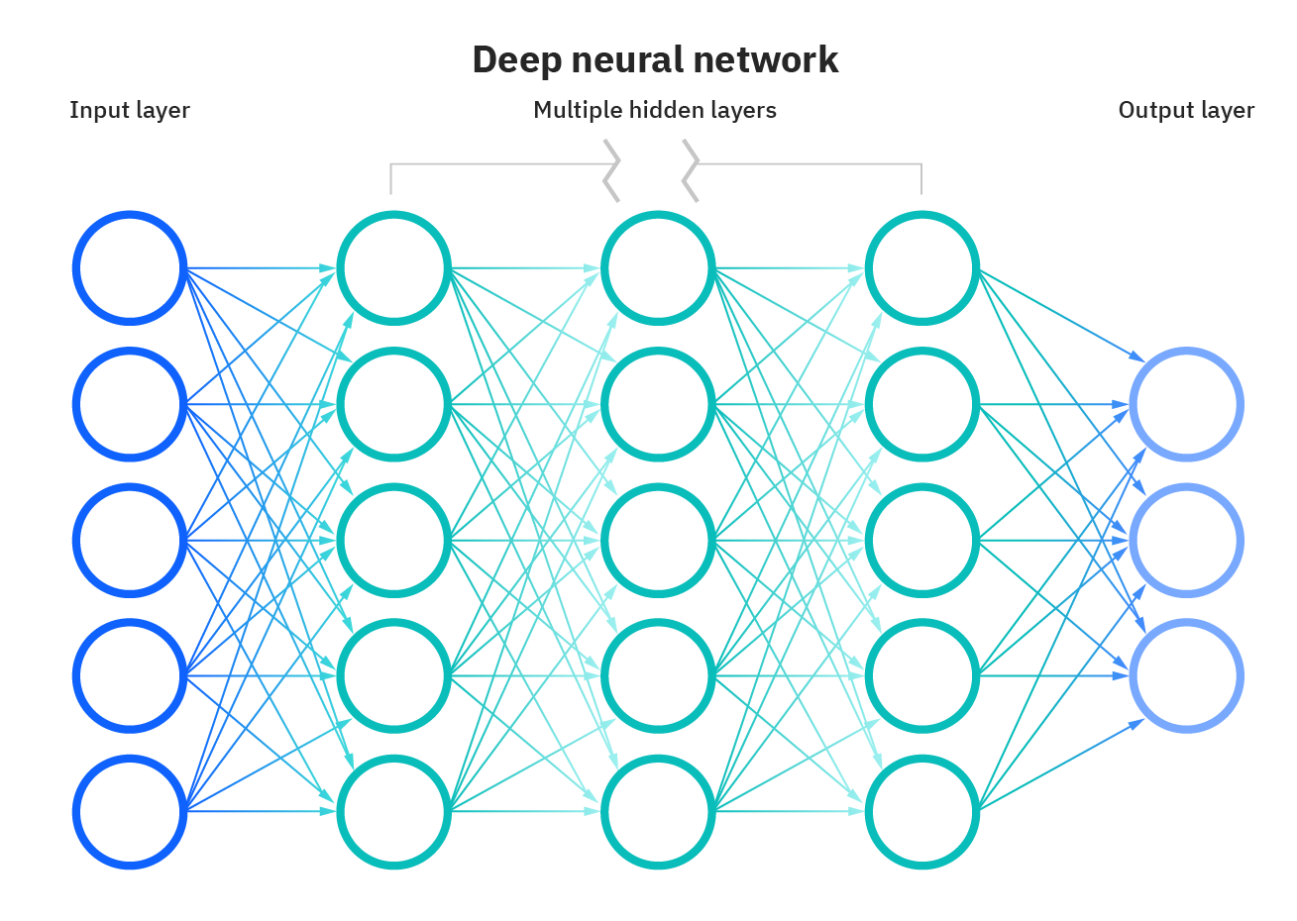
Deep Neural Network
Notes:
Deep Learning
deep learning is about computers learning to think using structures modeled on the human brain. A neural network consists of many Nodes (Neurons) in many layers. Each layer can have any number of nodes and a neural network can have any number of layers.
These interconnections exist between each node in the first layer with each and every node in the second layer. These are also called the weights between two layers.

Slide 7
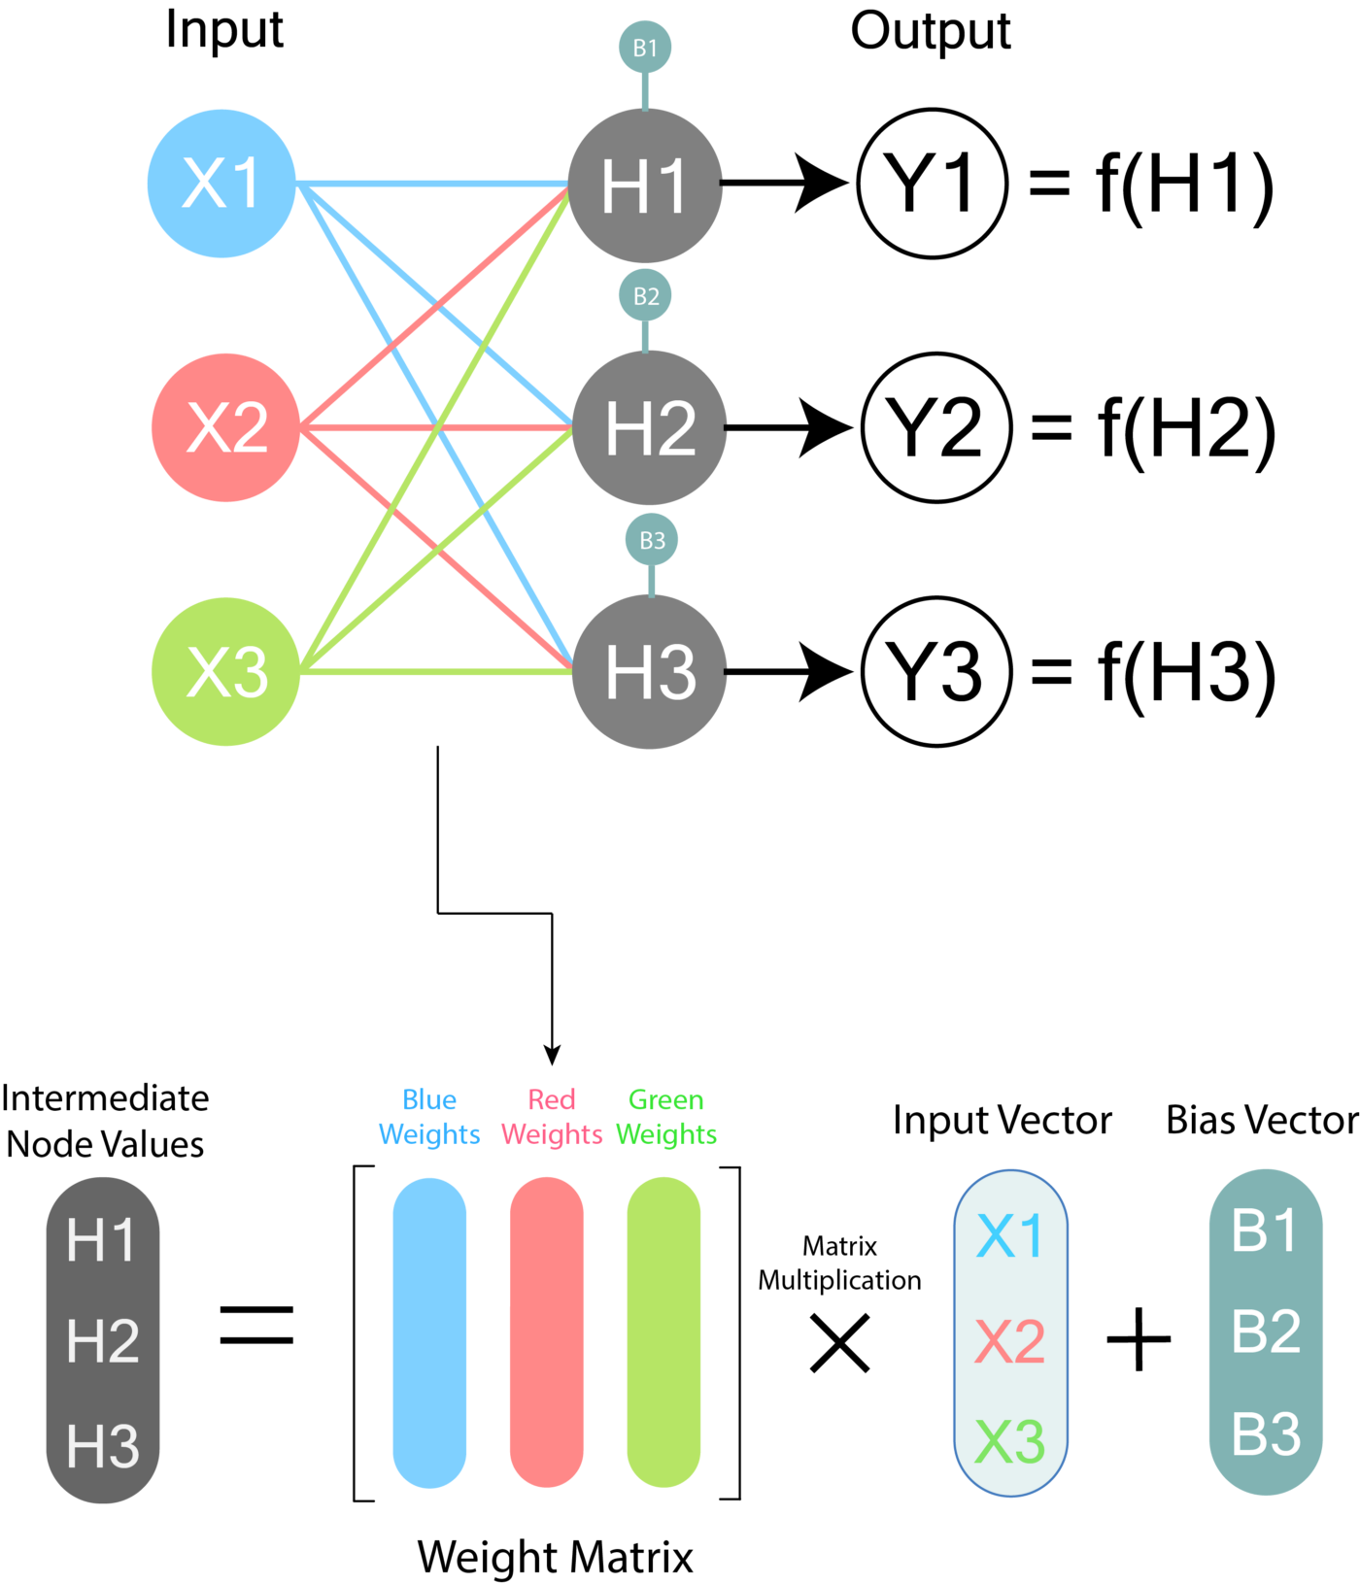
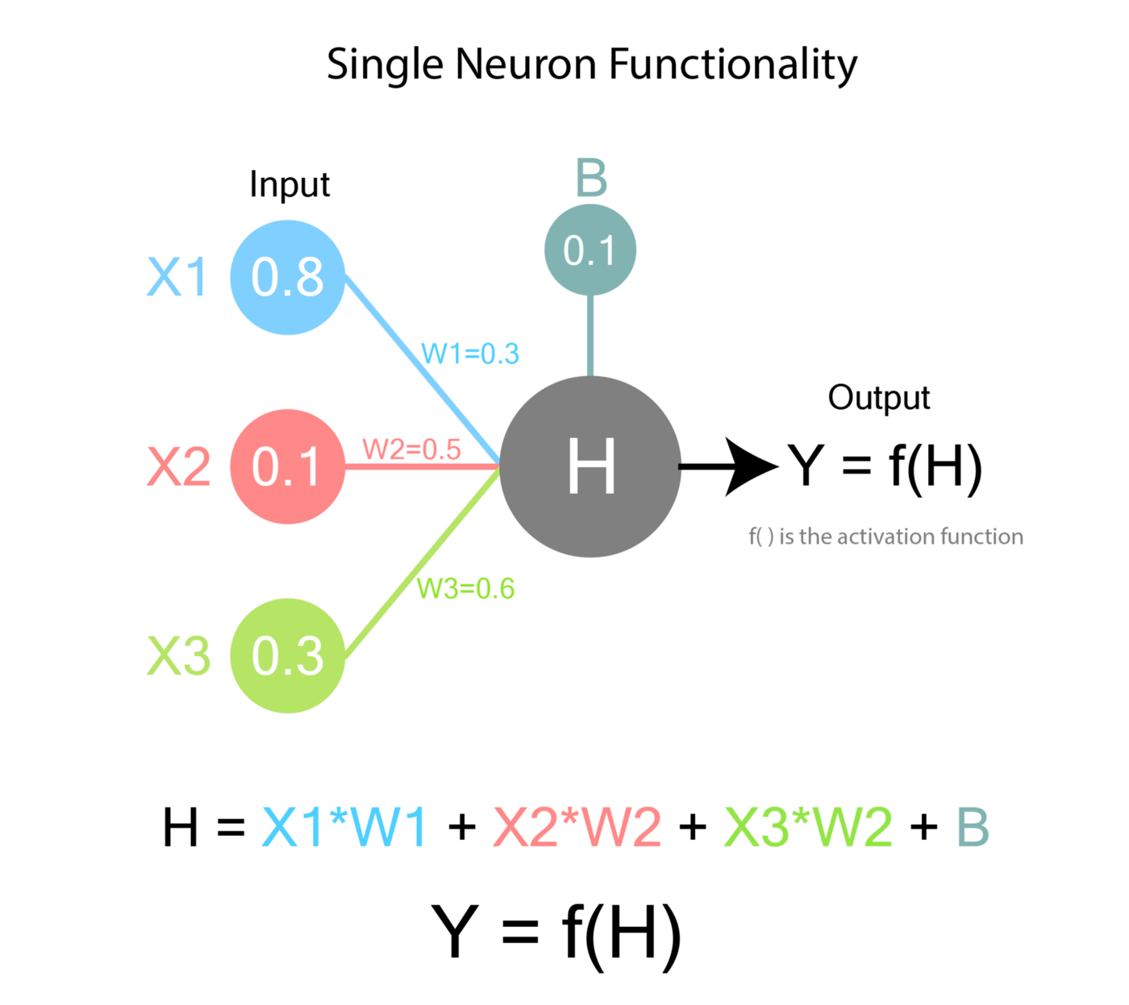
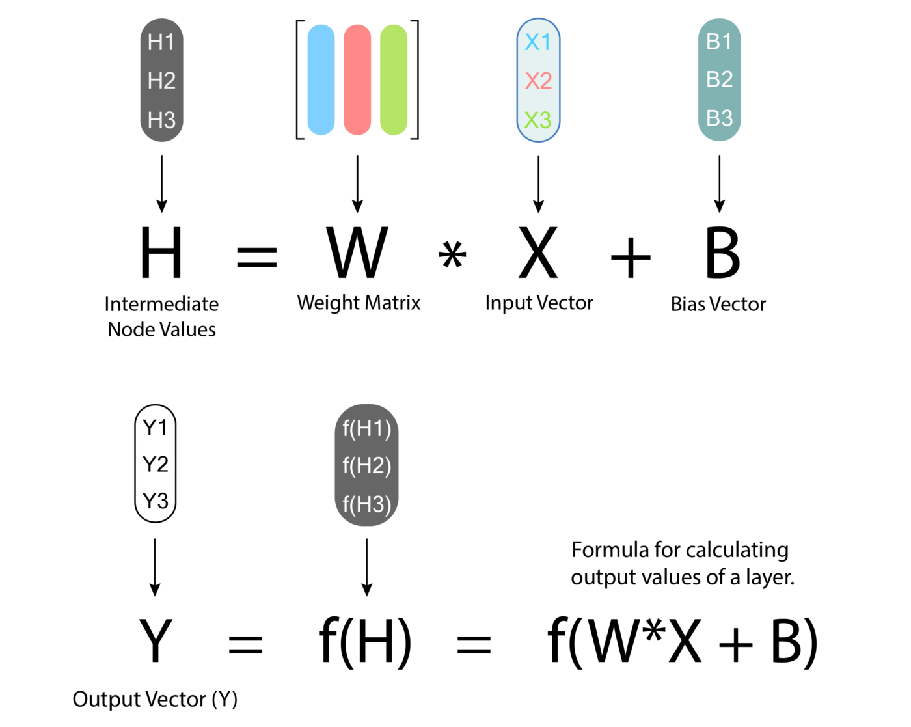
Deep Neural Network
Notes:
Deep Learning
deep learning is about computers learning to think using structures modeled on the human brain.
Y = the final value of the node.
W = the weights between the nodes in the previous layer and the output node.
X = the values of the nodes of the previous layer.
B = bias, which is an additional value present for each neuron. Bias is essentially a weight without an input term. It’s useful for having an extra bit of adjustability which is not dependent on previous layer.
H = the intermediate node value. This is not the final value of the node.
f( ) = Activation Function and it is something we can choose. We will go through its importance later.
So finally, the output value of this node will be f(0.57)

Slide 8
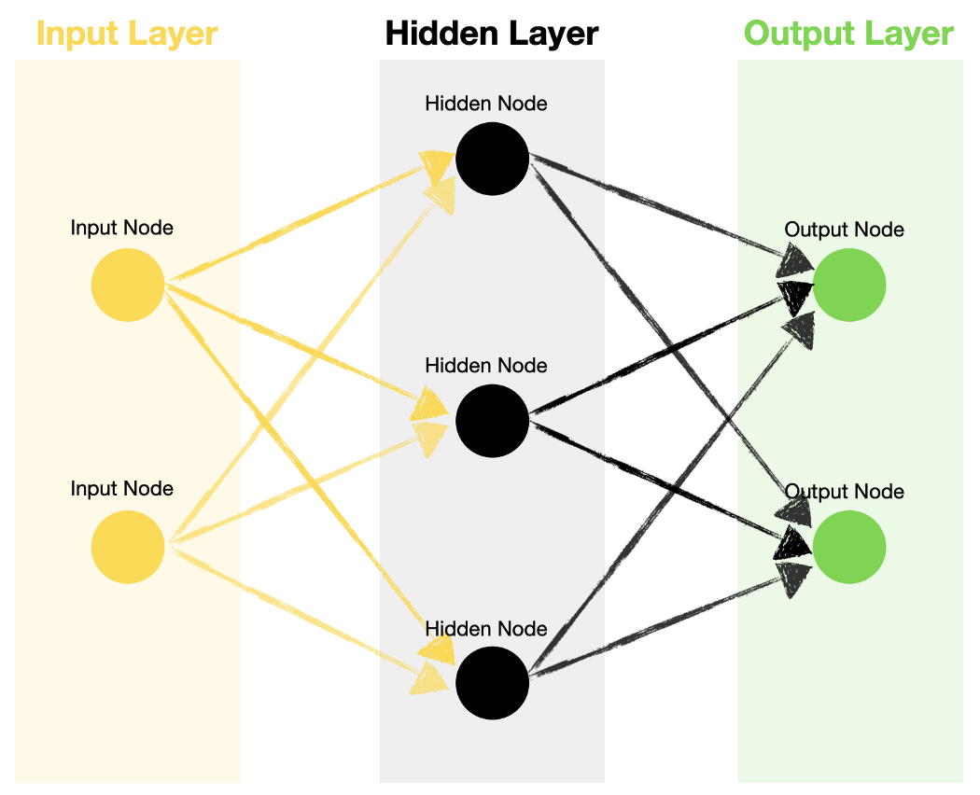
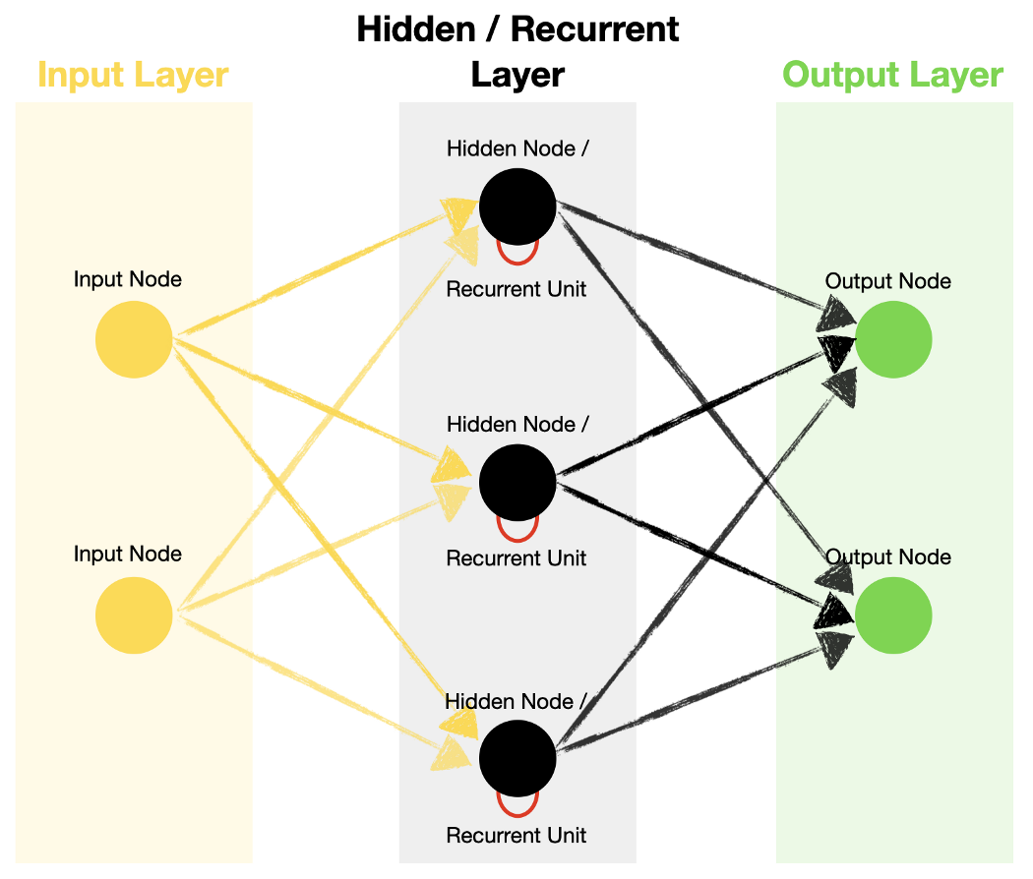
The Structure of Recurrent Neural Networks (RRNs)
Feed Forward Neural Network
Recurrent Neural Network
Notes:
It is 2-3-2 structure in the example but it could be any size
If we notice in there’s different the RNN have a built-in feedback loop, enabling the information to be passed back to the same node multiple times (timesteps)

Slide 9
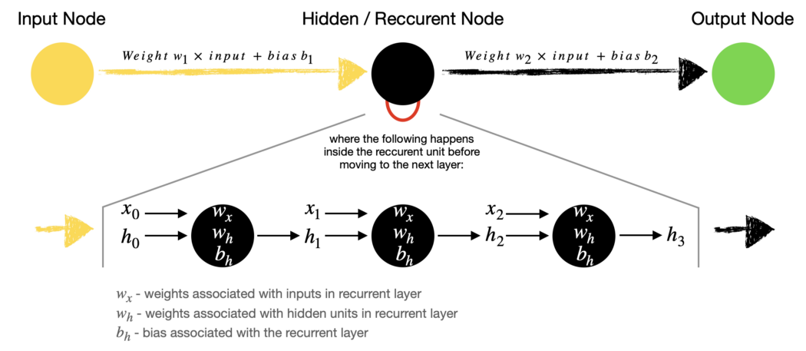
The Structure of Recurrent Neural Networks (RRNs)
Timestep

Slide 10
Activation Function
Deep neural network
represents a linear relationship between Y and X1,X2.
if we look at real world data, we realize this is not desirable because data often has nonlinear relationships between the input and output variables.
Notes:
Even though our neural network has a very complex configuration of weights, it will not be able to solve a problem without the activation function. The reason for this lies in the concept of Non-Linearity.
Regardless of what values W1 and W2 have, at the end of the day the change of value of X1 and X2 will result in a linear change in Y.

Slide 11
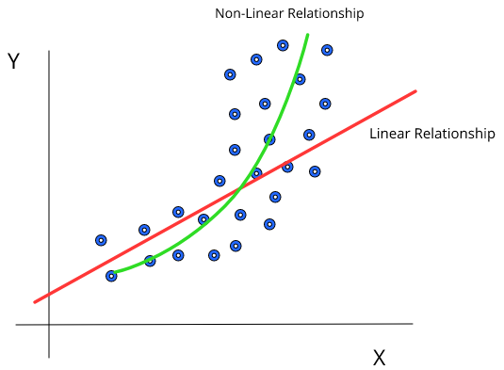
Activation Function
Deep neural network
The diagram represents a dataset which shows a non-linear relationship.
If we try to fit a linear relationship on the data, we will end up with the red line, which is not a very accurate representation of the data.
If our relationship can be non-linear, we are able to get the green line, which is much better
Notes:
The diagram represents a typical dataset which shows a non-linear relationship between X and Y. If we try to fit a linear relationship on the data, we will end up with the red line, which is not a very accurate representation of the data. However if our relationship can be non linear, we are able to get the green line, which is much better.

Slide 12
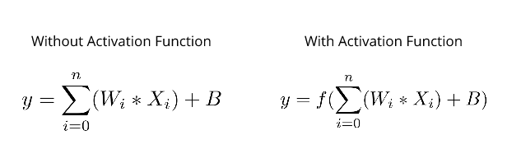
Activation Function
Deep neural network
IF the activation function is itself nonlinear. Hence all we have to do is keep some nonlinear function as the activation function for each neuron and our neural network is now capable of fitting on nonlinear data.
Notes:
there is a linear relationship between the input and the output. However, in the case of the equation with activation function, we can say that the relationship between input and output can be nonlinear, IF the activation function is itself nonlinear. Hence all we have to do is keep some nonlinear function as the activation function for each neuron and our neural network is now capable of fitting on nonlinear data.

Slide 13
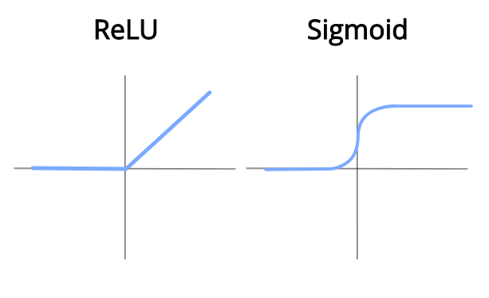
Activation Function
Deep neural network
ReLU: stands for Rectified Linear Unit. It essentially becomes an identity function (y = x) when x ≥ 0 and becomes 0 when x < 0. This is a very widely used activation function because its a nonlinear function and it is very simple.
Sigmoid: is essentially a function bounded between 0 and 1. It will become 0 for values which are very negative and 1 for values which are very positive. Hence this function squishes values which are very high or very low to values between 0 and 1.This function is usually used at the last layer when we need values which are binary (0 or 1).
Notes:
Deep Learning
deep learning is about computers learning to think using structures modeled on the human brain.

Slide 14


Why Is It Important To Initialize Our Weights?
Deep neural network
1. If we don’t initialize our weights, our neural network will not be able to learn anything and will be unable to make any predictions.
2. If we initialize our weights randomly, our neural network will be able to learn faster and be more accurate when making predictions.

Slide 15
Different Weight Initialization Techniques
Deep neural network
1- Zero Initialization (Initialized all weights to 0)
The derivative weight loss function is the same for every weight in W[l], thus all weights have the same value. This makes hidden layers symmetric, and this process continues for all the n iterations. Thus, initialized weights with zero make your network no better than a linear model.
Note: setting biases to 0 will not create any problems as non-zero weights take care of breaking the symmetry and even if bias is 0, the values in every neuron will still be different.

Slide 16
The Symmetry Problem
Deep neural network
When some machine learning models have all the weights initialized to the same value, it can be difficult or impossible for the weights to differ as the model is trained. This is the “symmetry”.
Solution: Initializing the model to small random values breaks the symmetry and allows different weights to learn independently of each other → Symmetry breaking

Slide 17
Different Weight Initialization Techniques
Deep neural network
2- Random Initialization (Initialized weights randomly)
This technique tries to address the problems of zero initialization since it prevents neurons from learning the same features of their inputs since our goal is to make each neuron learn different functions of its input and this technique gives much better accuracy than zero initialization.
In general, it is used to break the symmetry. It is better to assign random values except 0 to weights.
Notes:
Weight Initialization Techniques in Neural Networks (analyticsvidhya.com)

Slide 18
What happens if the weights initialized randomly can be very high or very low?”
Deep neural network
The problems are Vanishing and Exploding gradient descent. To solve these issues, one solution could be to initialize the parameters carefully.

Slide 19
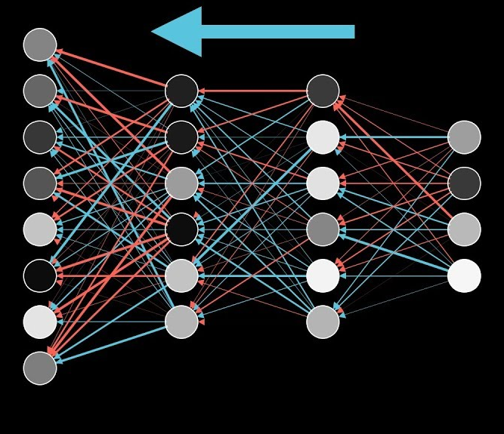
Backpropagation
Model building
Back propagation: allows the data to flow from the output backward while updating the parameters (weights and biases)
Definition: Back-Propagation is a method for supervised learning used by NN to update parameters to make the networks’ predictions more accurate. The parameter optimization process is achieved using an optimization algorithm called gradient decent.

Slide 20
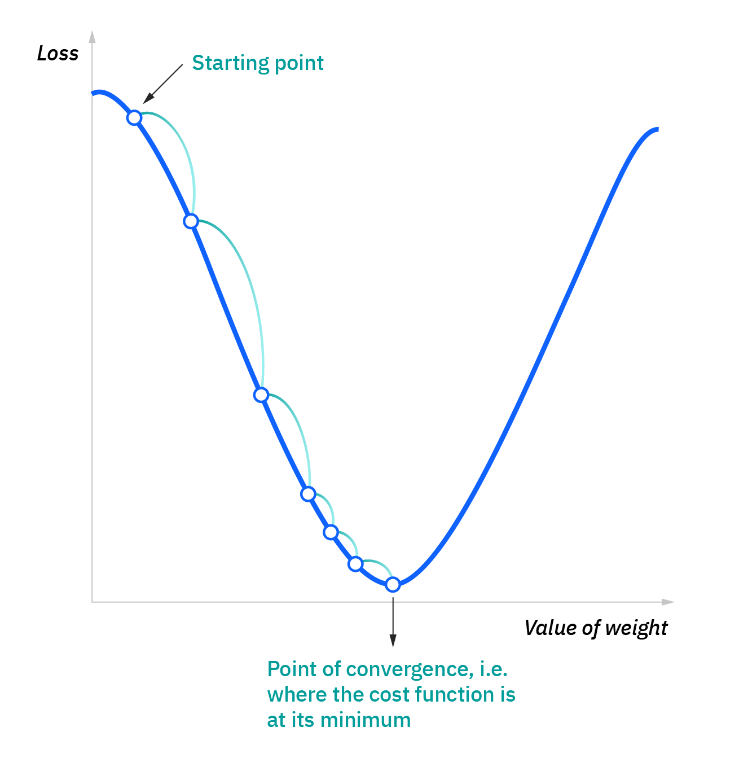
Gradient Decent
Model building
Gradient descent is an optimization algorithm that is commonly-used to train machine learning models and neural networks. Training data helps these models learn over time, and the cost function within gradient descent specifically acts as a barometer, gauging its accuracy with each iteration of parameter updates. Until the function is close to or equal to zero, the model will continue to adjust its parameters to yield the smallest possible error.
Notes:
Which direction should you step in this input space to decrease the output of the function most quickly/ what is the downhill direction
The gradient of the function give you the direction of steepest increase meaning which direction should you step to increase the function most quickly
Taking the negative of the gradient give you the direction to step that deceases the function most quickly
The length of the gradient vector is an indication for just how steep that steepest slope is

Slide 21
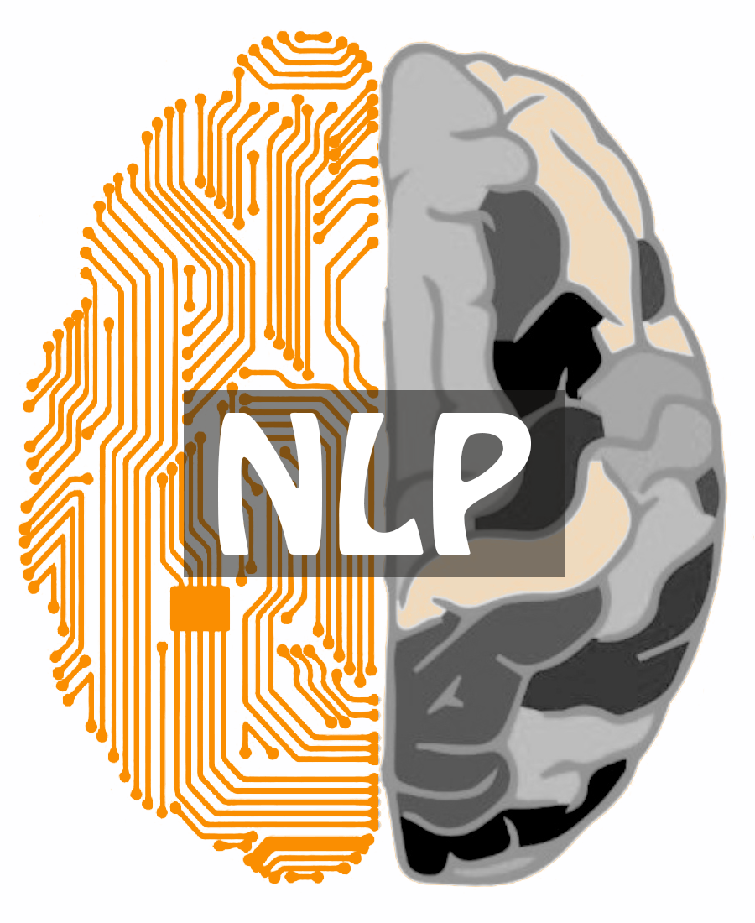
Natural language processing concerned with giving computers the ability to understand text and spoken words in much the same way human beings can.
Notes:
We’ll start with NLP

Slide 22
Aim of Natural Language Processing
NLP
NLU
NLG
Uses syntactic and semantic analysis of text and speech to determine the meaning of the sentence
is the process of producing a human language text response based on some data input
Notes:
NLP, paired with NLU (Natural Language Understanding) and NLG (Natural Language Generation), aims at developing highly intelligent and proactive search engines, grammar checkers, translates, voice assistants, and more.
NLG: Example Markov chain

Slide 23

NLP Challenges
Words can have different meanings. Slangs can be harder to put out contextual. And certain languages are just hard to feed in, owing to the lack of resources. Despite being one of the more sought-after technologies, NLP comes with the following rooted and implementation AI challenges.
Lack of Context
Ambiguity
Notes:
- Lack of Context for Homographs, Homophones, and Homonyms
A ‘Bat’ can be a sporting tool and even a tree-hanging, winged mammal. Despite the spelling being the same, they differ when meaning and context are concerned. Similarly, ‘There’ and ‘Their’ sound the same yet have different spellings and meanings to them.
● Ambiguity
If you think mere words can be confusing, here are is an ambiguous sentence with unclear interpretations.
“I snapped a kid in the mall with my camera”- If the spoken to, it can be the case that the machine gets confused as to whether the kid was snapped using the camera or when the kid was snapped, he had your camera.
This form of confusion or ambiguity is quite common if you rely on non-credible NLP solutions. As far as categorization is concerned, ambiguities can be segregated as Syntactic (meaning-based), Lexical (word-based), and Semantic (context-based).

Slide 24


NLP Steps
1- Data collection
2- Data exploration and visualization
3- Data pre-processing
4- Model building
5- Model evaluation

Slide 25
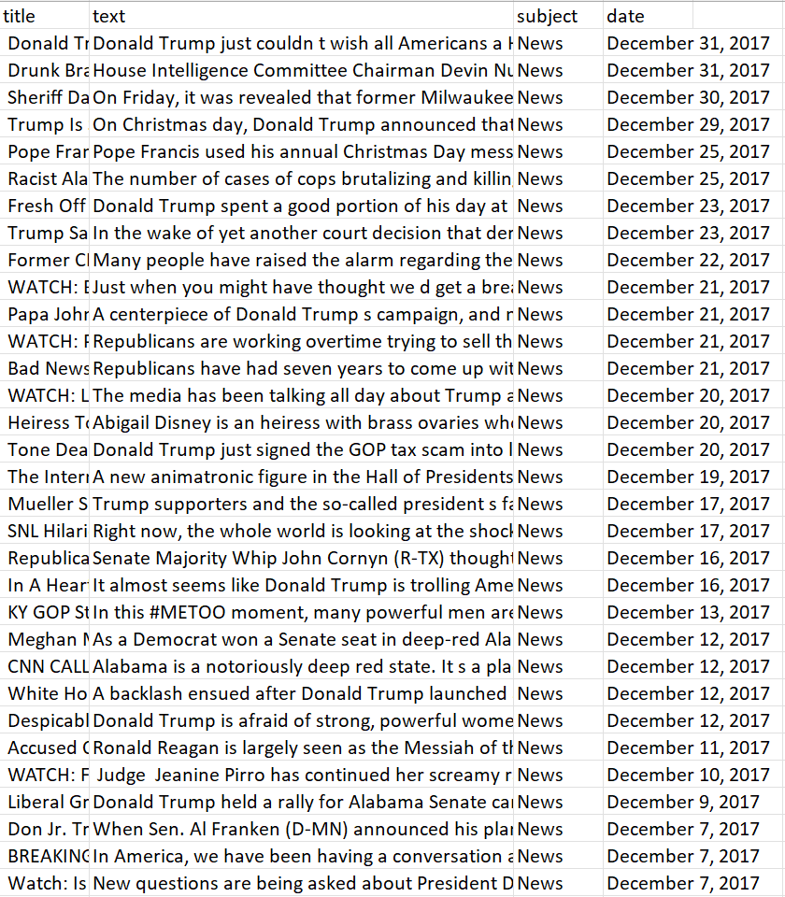
Fake Dataset
The dataset contain a set of fake news with 4 columns and 23481 rows:
1- title
2- text
3- subject
4- date
Notes:
Fake and real news dataset | Kaggle

Slide 26

Real Dataset
The dataset contain a set of real news with 4 columns and 21417 rows :
1- title
2- text
3- subject
4- date
Notes:
Fake and real news dataset | Kaggle

Slide 27
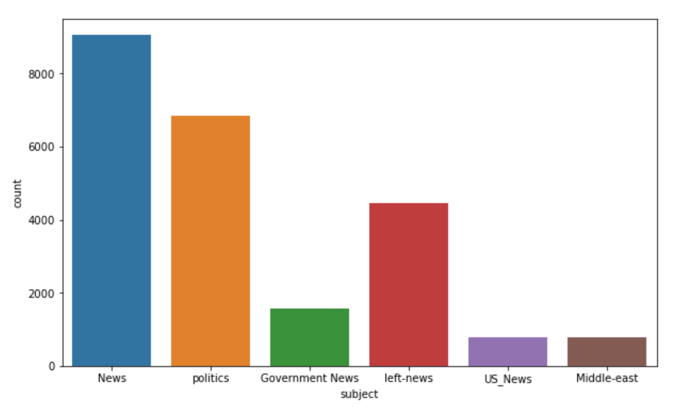
What is the most frequent subject in fake dataset?

Slide 28
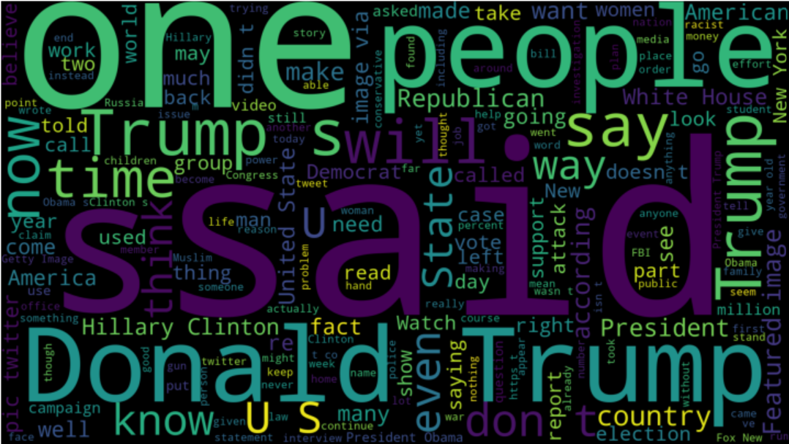
Word cloud visualizing the most frequent subject in fake dataset

Slide 29
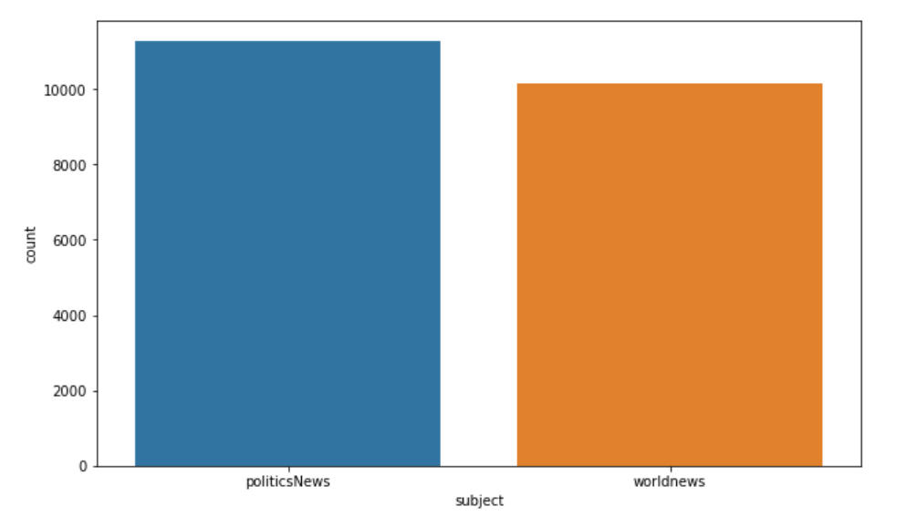
What is the most frequent subject in real dataset?

Slide 30

Word cloud visualizing the most frequent subject in fake dataset

Slide 31
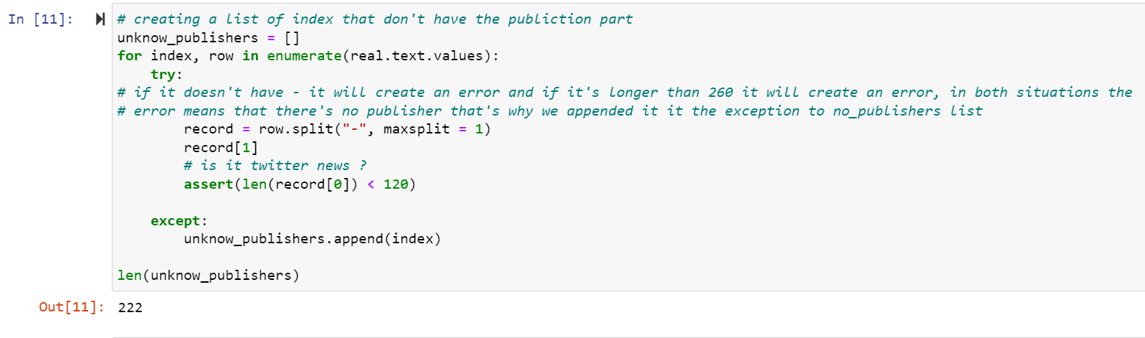
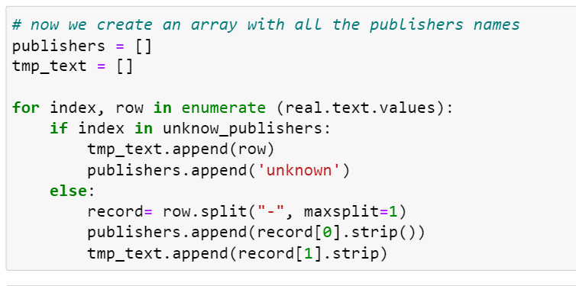
Unknow / Known Publishers
EDA

Slide 32

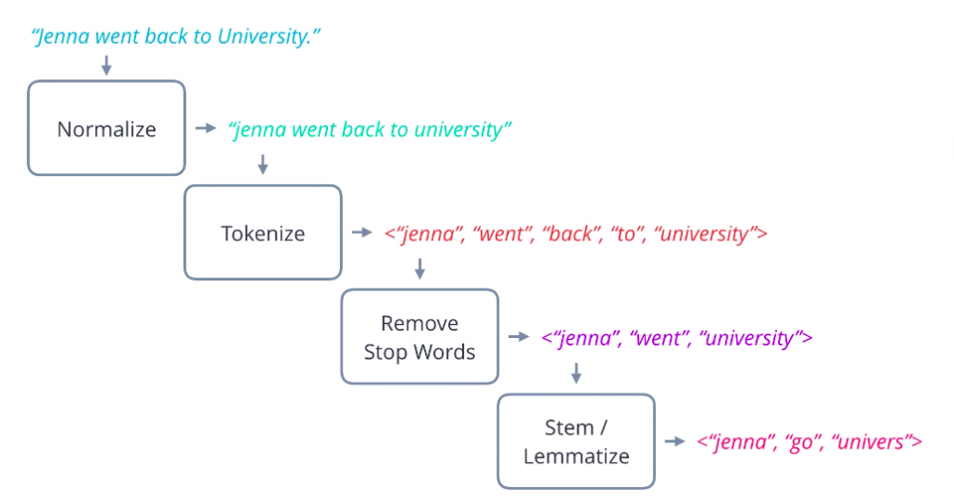
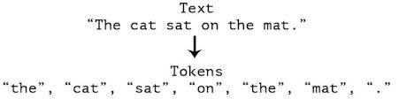
Data Pre-processing
Noise Removal
Deletes or transform things in text that degrade the NLP task model:
Remove text file headers, footers
Remove HTML, XML, etc. markup and metadata
Extract valuable data from other formats: JSON, within the database
Normalization
Normalization refers to series of related tasks meant to put all text in same playing field it consist of:
1- Stemming: running → run
2- Lemmatization: better → good
3- Everything else
Tokenization
Tokenization is step which splits longer strings of text into smaller pieces.
Notes:
3- Everything else:
set all characters to lowercase
remove numbers (or convert numbers to textual representations)
remove punctuation (generally part of tokenization, but still worth keeping in mind at this stage, even as confirmation)
strip white space (also generally part of tokenization)
remove default stop words (general English stop words)

Slide 33
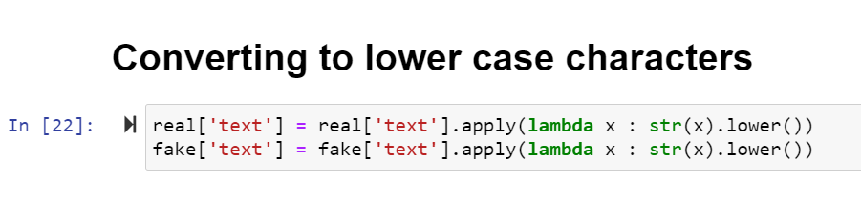
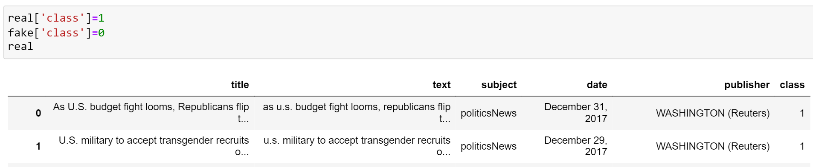
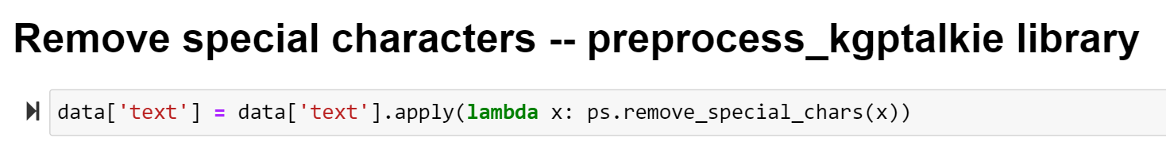
Normalization
Data Pre-processing
1.
2.
3.
Notes:
Converted to lower case
Added binary classification class in both data sets
Removed special characters

Slide 34
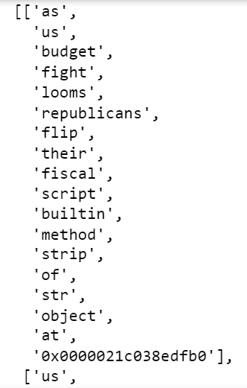
split() / tolist()
Data Pre-processing
As U.S budget fight looms, Republicans flip their first fiscal script →

Slide 35
Vectorization
Data Pre-processing
Machine learning and deep learning needs data in the numeric form. We basically used encoding technique (BagOfWord, TF-IDF, Word2Vec) to encode text into numeric vector.
Word2Vec:
We choose Word2Vec because in BagOfWord and TF-IDF every word was treated as individual entity, and semantics were completely ignored. With the introduction of Word2Vec, the vector representation of words was said to be contextually aware.
Notes:
Second step vectorization

Slide 36
Vectorization – Word2Vec
Data Pre-processing
Word2Vec
king – man + woman = queen
Skip-Gram
CBOW
Skip-Gram method in which we provide a word to our Neural Network and ask it to predict the context.
CBOW stands for Continuous Bag of Words. In the CBOW approach instead of predicting the context words, we input them into the model and ask the network to predict the current word.
Notes:
There are two algorithm to use with Word2Vec which is:
CBOW is the default

Slide 37
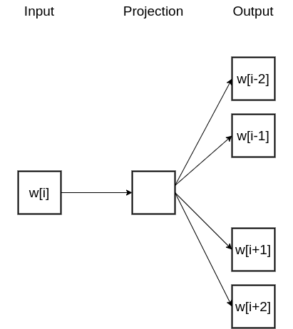
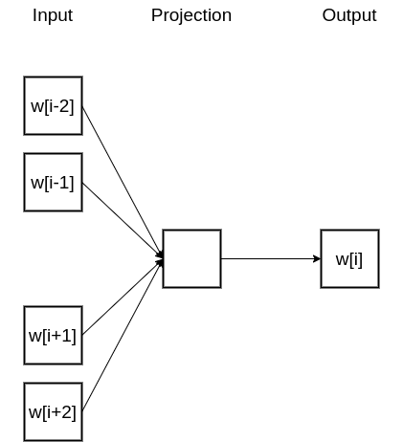
Vectorization – Word2Vec
Data Pre-processing
Skip-Gram
CBOW

Slide 38
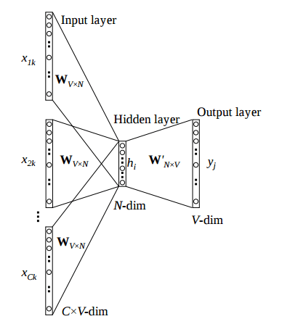
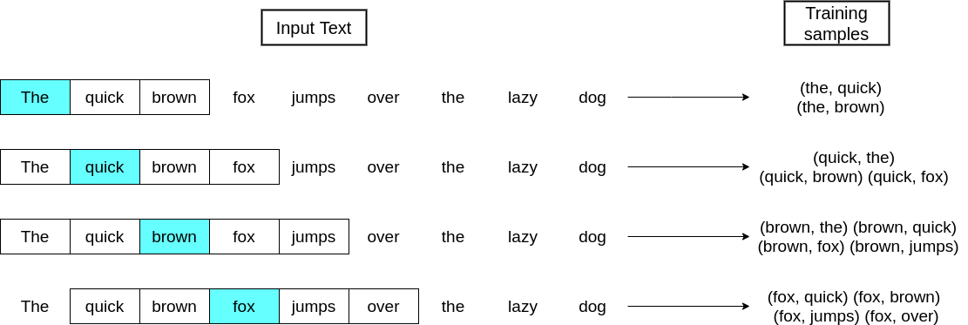
Vectorization – Word2Vec
Data Pre-processing
Skip-Gram
CBOW
Notes:
Vectorization Techniques in NLP [Guide] - neptune.ai

Slide 39
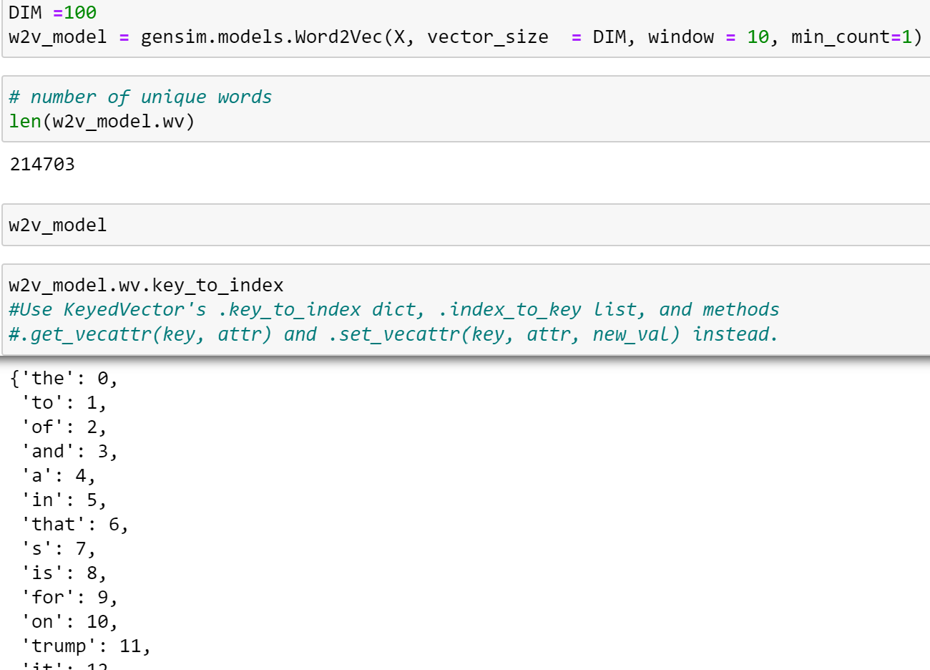
Vectorization
Data Pre-processing

Slide 40
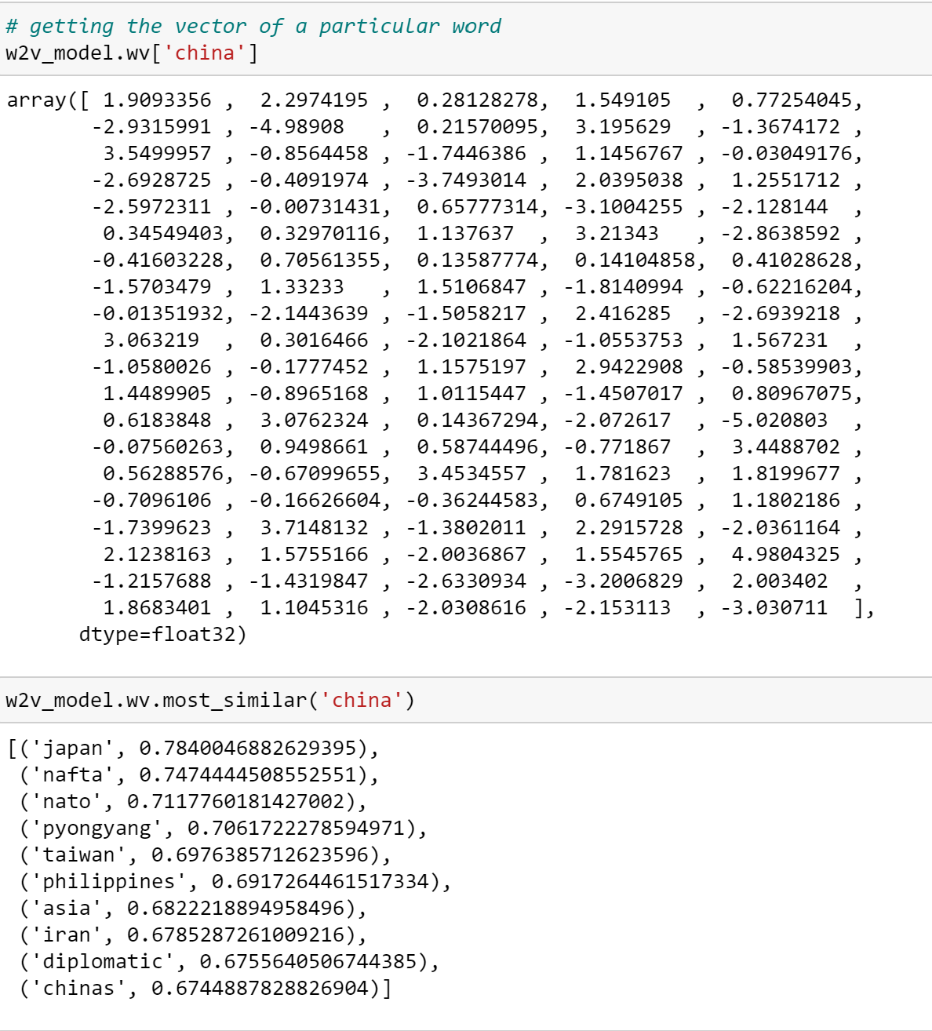
Vectorization
Data Pre-processing

Slide 41
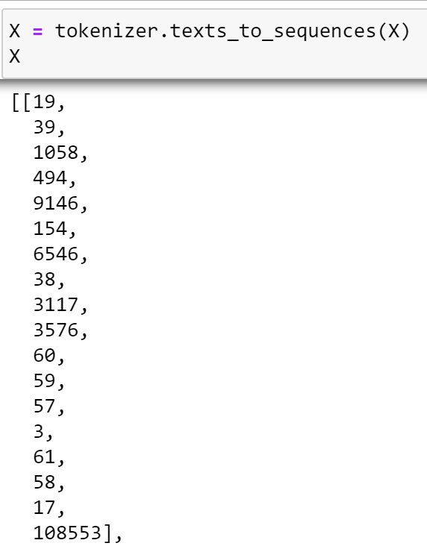
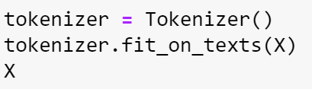
Tokenization
Data Pre-processing
→
→
Notes:
We used tokenization after vectorization, this step is said to reduce the training time of machine/deep learning.

Slide 42
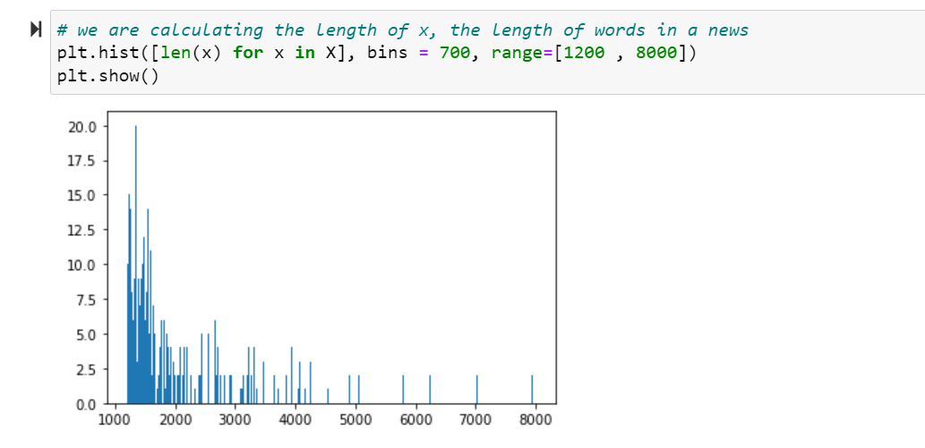
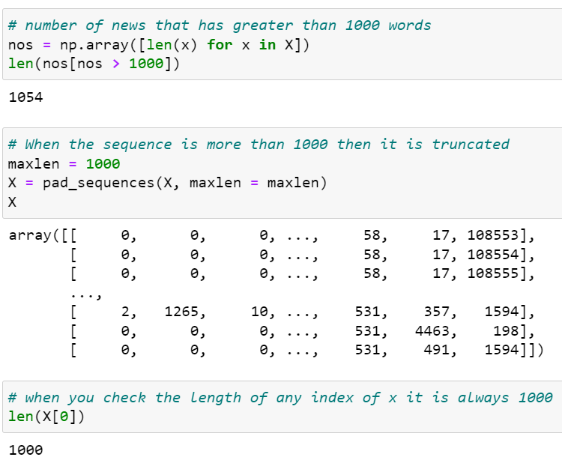
Length of x The length of words in the news
Model building
The above code will pad every sequence. Following is the output after applying the pad_sqeuences function. We can see that every sequence has a length of 1000 numbers.
Notes:
LSTM: To understand the pattern in a long sequence of data, we need networks to analyze patterns across time. Recurrent Networks is the one usually used for learning such data. They are capable of understanding long- and short-term dependencies and temporal difference
Dense: The last dense layer is added to get output in format needed by the user
pad_sequences is used to ensure that all sequences in a list have the same length. By default this is done by padding 0 in the beginning of each sequence until each sequence has the same length as the longest sequence.

Slide 43
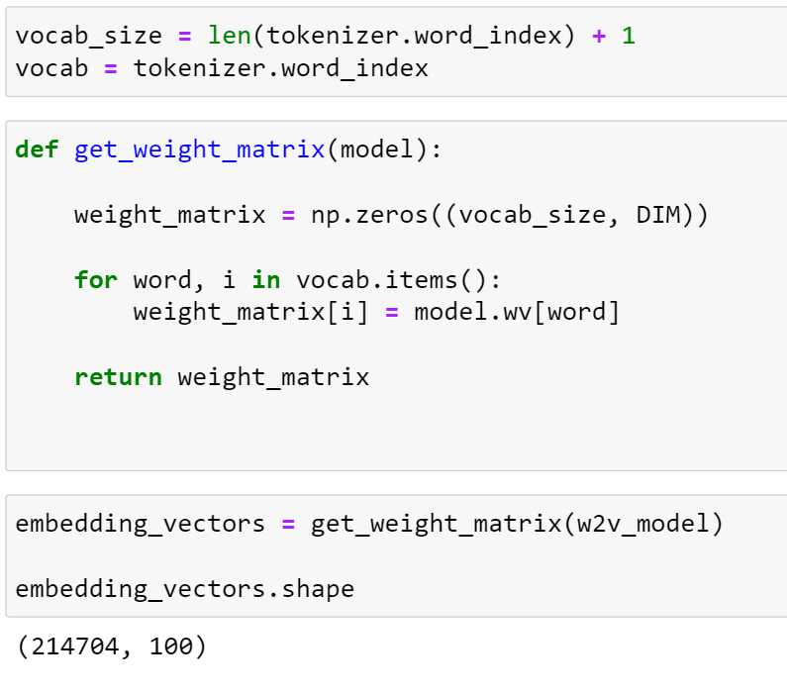
Weight Matrix
Model building
Notes:
Initializing my model weights with pre-trained word2vec model

Slide 44
Sequential
Model building
The Sequential model is a linear stack of layers.
Sequential
Embedding
LSTM
Dense
Notes:
What is a sequential model?
In sequential models, the input, hidden and output layers are stacked in the model sequentially (hence the name). The information propagates from the input to the output through hidden layers. The feedback happens only at the output layer through the backpropagation and there is no feedback between intermediate hidden layers. Sequential models are also called Feed-Forward Neural Networks (FFNN) models.
In Keras, the sequential models can be built using the Sequential() class.

Slide 45
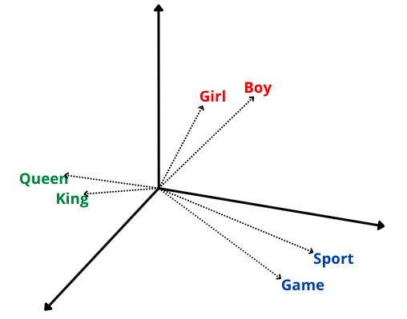
Embedding
Model building
What is word embedding?
Word embedding is a technique to represent the word with the vector of numbers.
Word embedding means text as numbers.
Two vectors in the vector space are closer to each other =
the two words are expected to have a similar meaning.
Notes:
The image shows that the words “Girl” and “Boy” are related to each other, so they are placed close to each other in a vector space.

Slide 46
Embedding
Model building
What is the embedding layer in Keras?
Keras provides an embedding layer that converts each word into a fixed-length vector of defined size. in embedding layers, every word has a real-valued vector of fixed length.
The main advantage: of this technique. Due to the reduction in dimensions, the representation of a word takes minimum space compared to one-hot-encoding.
The embedding layer requires integer encoded input data to represent each word uniquely.
The output: of the embedding layer is a 2D vector where every vector represents a single word from the vocabulary.

Slide 47
Sequential
Model building
The Sequential model is a linear stack of layers.
Sequential
Embedding
LSTM
Dense
Notes:
What is a sequential model?
In sequential models, the input, hidden and output layers are stacked in the model sequentially (hence the name). The information propagates from the input to the output through hidden layers. The feedback happens only at the output layer through the backpropagation and there is no feedback between intermediate hidden layers. Sequential models are also called Feed-Forward Neural Networks (FFNN) models.
In Keras, the sequential models can be built using the Sequential() class.

Slide 48
LSTM
Model building
RNN
David, a 36-year-old man lives in San Francisco. He has a female friend Maria. Maria works as a cook in a famous restaurant in New York whom he met recently in a school alumni meet. Maria told him that she always had a passion for _________ .
we want our network to learn from dependency ‘cook’ to predict ‘cooking. There is a gap between the information what we want to predict and from where we want it to get predicted . This is called long-term dependency. We can say that anything larger than trigram as a long-term dependency. Unfortunately, RNN does not work practically in this situation.

Slide 49
LSTM
Model building
What is LSTM?
is a variation of a recurrent neural network (RNN) that is quite effective in predicting the long sequences of data like sentences and stock prices over a period.
It differs from a normal feedforward network because there is a feedback loop in its architecture. It also includes a special unit known as a memory cell to withhold the past information for a longer time for making an effective prediction.
In fact, LSTM with its memory cells is an improved version of traditional RNNs which cannot predict using such a long sequence of data and run into the problem of vanishing gradient.

Slide 50
Sequential
Model building
The Sequential model is a linear stack of layers.
Sequential
Embedding
LSTM
Dense
Notes:
What is a sequential model?
In sequential models, the input, hidden and output layers are stacked in the model sequentially (hence the name). The information propagates from the input to the output through hidden layers. The feedback happens only at the output layer through the backpropagation and there is no feedback between intermediate hidden layers. Sequential models are also called Feed-Forward Neural Networks (FFNN) models.
In Keras, the sequential models can be built using the Sequential() class.

Slide 51
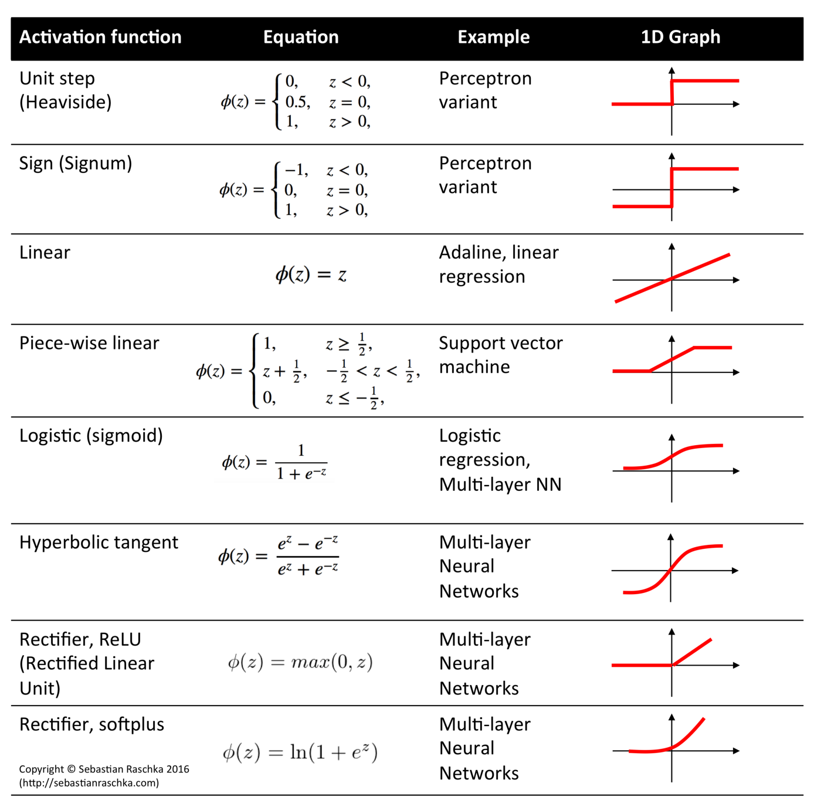
Dense Layer
Model building
A dense layer or a fully connected layer is a layer where every neuron from the previous layer connects with every neuron of the next layer
The dense layer is one of the most used layers in designing deep neural networks. The figure below shows the various options of the Dense layer provided by the Keras library.

Slide 52
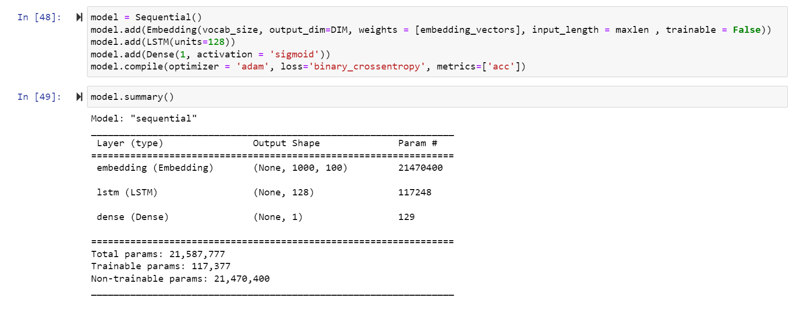
Sequential
Model building
Notes:
Embedding: enables to convert each word into fixed length vector of defined size/ make it easier to do machine learning on large inputs, embedding capture some of the semantic of the input by placing semantically similar input closer
LSTM: To understand the pattern in a long sequence of data, we need networks to analyze patterns across time. Recurrent Networks is the one usually used for learning such data. They are capable of understanding long- and short-term dependencies and temporal difference
Dense: The last dense layer is added to get output in format needed by the user
Metric[accuracy ] = calculate how often predictions equal labels

Slide 53
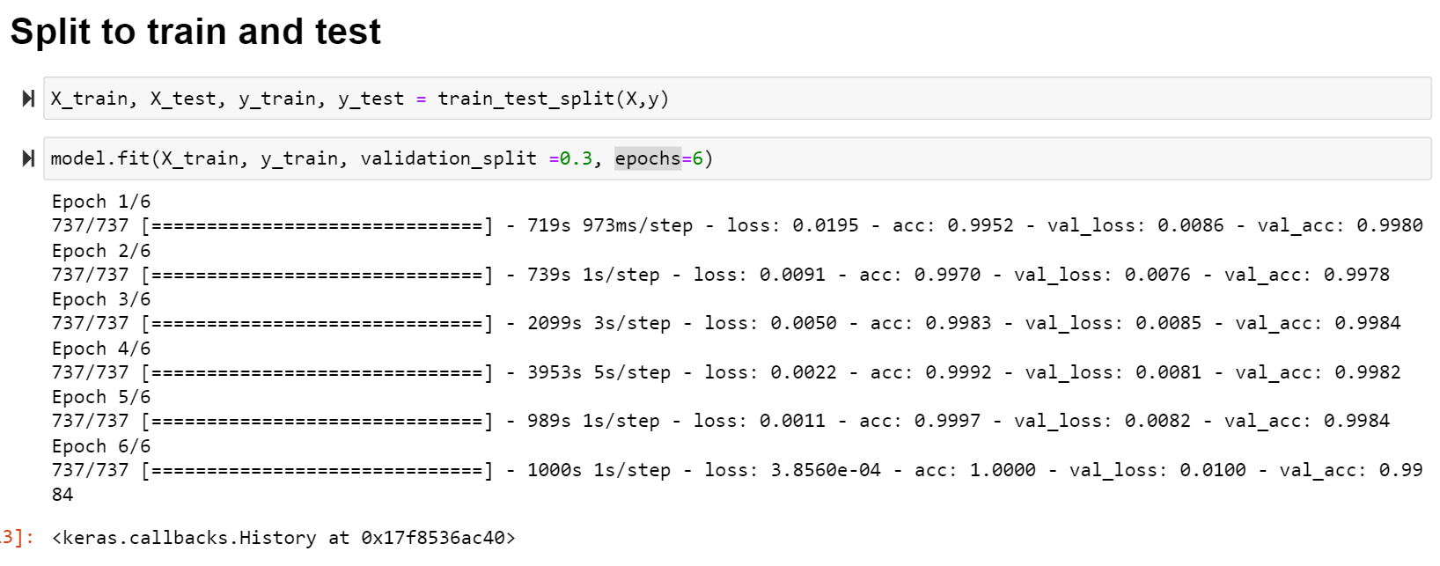
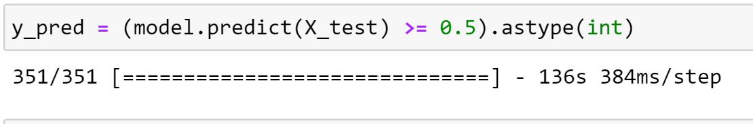
Train and test split
Model building

Slide 54
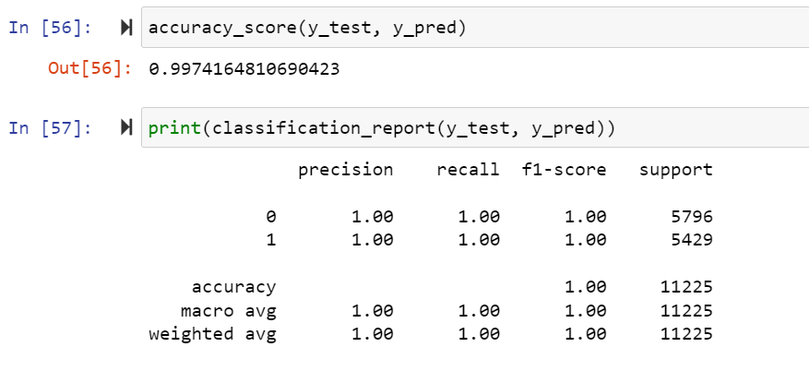
Model Evaluation
Notes:
F1 = the weighted average of precision and recall
Precision = actual correct prediction/total prediction made by a model
Recall = TP/TP*FN
Support = number of samples of the true response that lie in that class

Slide 55
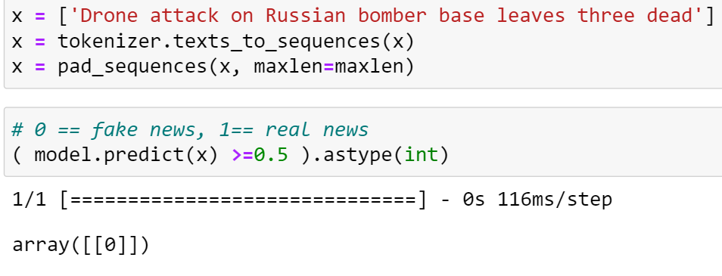
Testing With External Text Data

Slide 56
Thank you

Slide 57
Embedding
Model building
To embed each word, we need to perform the following steps:
Import all the necessary libraries.
Convert all the sentences into words, i.e., tokenize all the sentences into words.
Define every sentence in the form of a one-hot-encoded vector.
Use pre-padding or post-padding to make the length of every one-hot-encoded vector the same.
Serve these padded vectors as input for embedded layers.
To predict the label, flatten it and apply a dense layer.

Slide 58
Common Problems
Deep neural network
Deep Neural Networks is Vanishing and Exploding gradient descent. To solve these issues, one solution could be to initialize the parameters carefully.
Notes:
there is a linear relationship between the input and the output. However, in the case of the equation with activation function, we can say that the relationship between input and output can be nonlinear, IF the activation function is itself nonlinear. Hence all we have to do is keep some nonlinear function as the activation function for each neuron and our neural network is now capable of fitting on nonlinear data.

Slide 59
Backpropagation
Model building
Cost function:
A way to make the neural network or the computer to choose a single output placing the others at 0 the output is small when it guesses the image correctly, but it is large when it doesn’t know what it is doing then we take the average cost of all the training data this average cost is the measure of how lousy the network is
After that we want to tell this computer how to change these biases, so it gets better, there is multiple ways using calculus however, it doesn’t work on highly complicated function
So, we use gradient decent
To reach a local minima = Doable
To reach a global minima = extremely hard

Slide 60
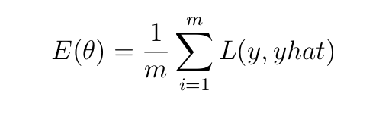

Slide 61
Backpropagation
Model building
Cost of a single training example:
You take the output that the network gives, with the output that you wanted it to give and you just add up the square differences between each component. Doing that for all of the tens of thousands of training examples, and averaging the results this give you the total cost of the network (Real - expected)^2+(Real1 – expected1)^2+ ….
We are looking for the negative gradient of this cost function, which tells you how you need to change all the weights and biases, all of these connections, to most efficiently decrease the cost.

Slide 62
Backpropagation
Model building
In our specially designed weight function changing the weight and biases to decrease it meaning making the output of the network on each peace of the training data look less like a random array of 10 values and more like an actual decision that we want to make
The cost function involves average over all the training data so if you minimize it it means it is better performance on all of these samples
The algorithm for computing this gradient efficiently which is effectively the heart of how a neural network learns is called backpropagation
The process of repeatedly nudging an input of a function by some multiple of the negative gradient is called gradient decent, it is a way to converge towards some local minimum of a cost function

Slide 63
Sequential
Model building
What is a sequential model?
In sequential models, the input, hidden and output layers are stacked in the model sequentially (hence the name). The information propagates from the input to the output through hidden layers. The feedback happens only at the output layer through the backpropagation and there is no feedback between intermediate hidden layers. Sequential models are also called Feed-Forward Neural Networks (FFNN) models.
In Keras, the sequential models can be built using the Sequential() class.

Slide 64
Backpropagation
Model building
Backpropagation is an algorithm for computing that crazy complicated gradient. Because thinking of gradient vector as a direction in 13,000 dimensions is beyond our imagination. So we think about it as the magnitude of each components here is telling you how sensitive the cost function is to each weight and bias

Slide 65
Backpropagation
Model building
Back-propagation allows the data to flow from the output backward while updating the parameters (weights and biases)
Definition: Back-Propagation is a method for supervised learning used by NN to update parameters to make the networks’ predictions more accurate. The parameter optimization process is achieved using an optimization algorithm called gradient decent.

Slide 66
Deep Neural Network
→
Notes:
Deep Learning
deep learning is about computers learning to think using structures modeled on the human brain.

Slide 67
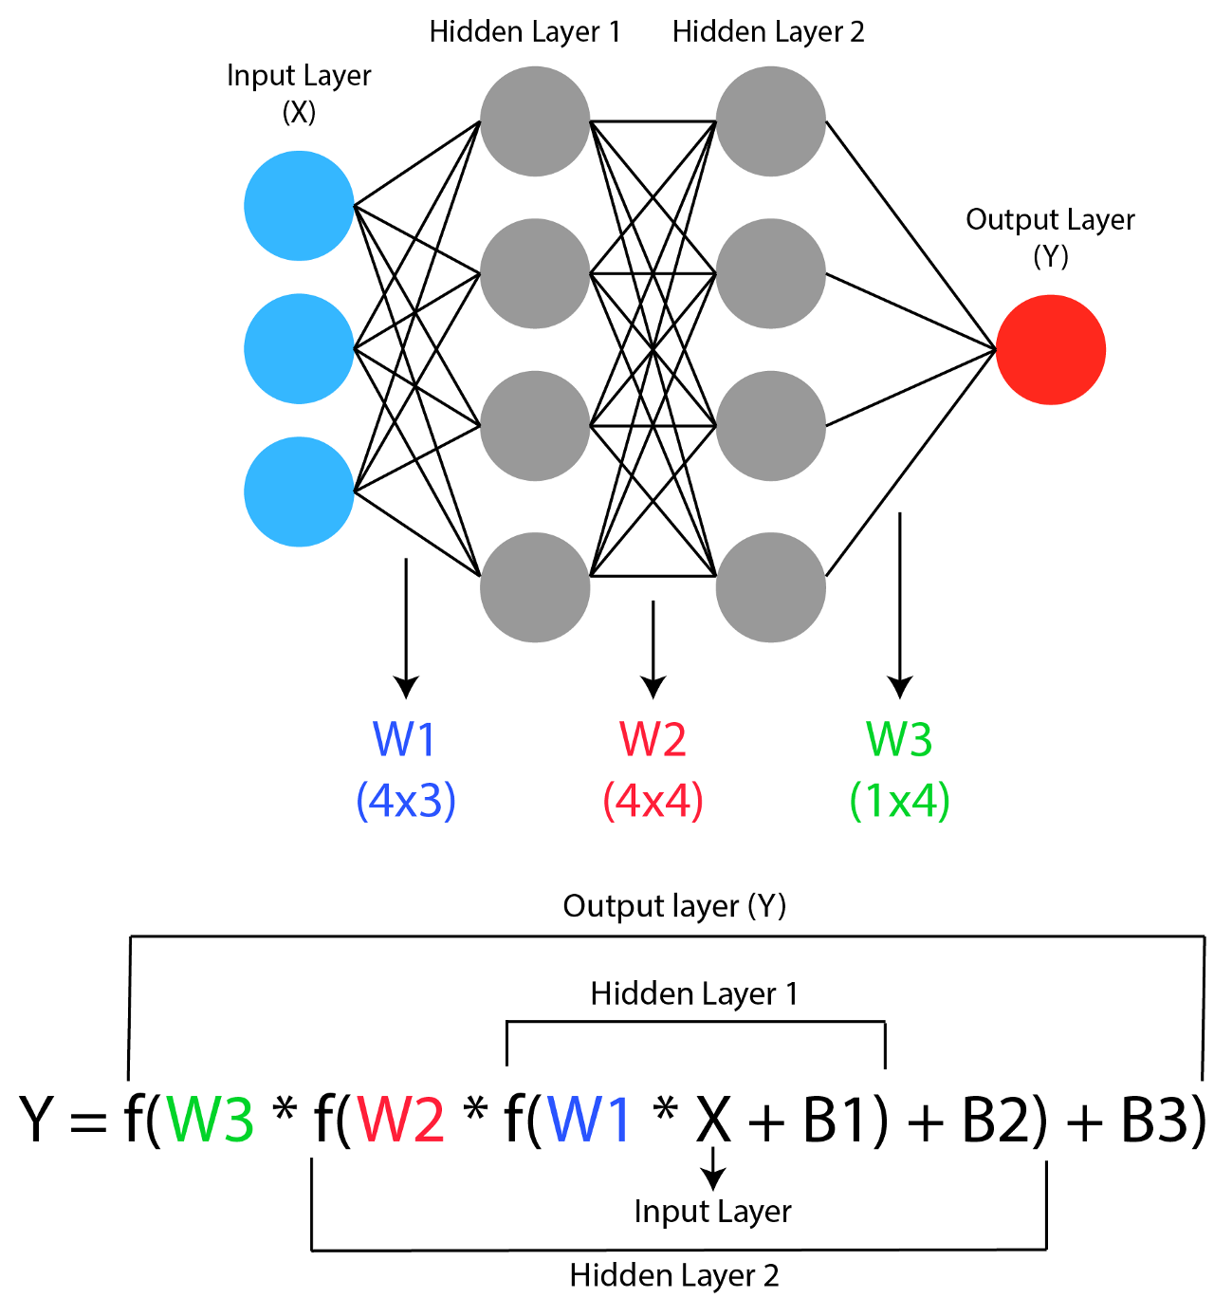
Deep Neural Network
neural network is, simply put, a series of matrix multiplications and activation functions. When we input a vector containing the input data, the data is multiplied with the sequence of weight matrices and subjected to activation functions till it reaches the output layer, which contains the predictions of the neural network corresponding to that input.
Notes:
Deep Learning
deep learning is about computers learning to think using structures modeled on the human brain.

Slide 68
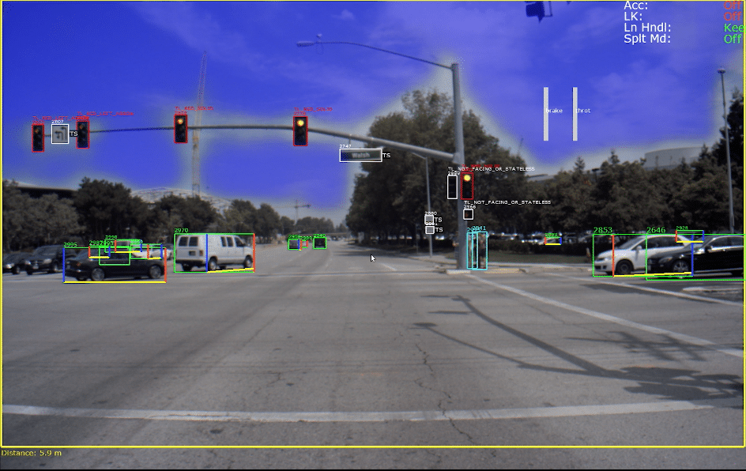
Machine Leaning vs. Deep Learning Example
Notes:
For example self driving cars If it is uses machine learning it will manually ask the driver to d

Slide 69
